Slide 1
Design and Control of the BlueFoot Platform:
A Multi-terrain Quadruped Robot
Brian Cairl
Dr. Farshad Khorrami
May 13, 2015

Slide 3
Overview
Introduction
Hardware and Design
Software Architecture
System Modeling
Gait and Stability Control
Navigation Control
Concluding Remarks

Slide 4
Introduction: Quadruped Robotics
Inspired by notable quadruped robotic systems from the past decade:
LittleDog (Boston Dynamics)
BigDog (Boston Dynamics)
Tekken (Kyoto Institute of Technology)
Kolt (Stanford University)
HyQ (Istituto Italiano di Tecnologia)

Slide 5
Introduction: Quadruped Robotics
Well known advantages over wheeled robots, mainly in adaptability to terrain
At the follows expenses:
Higher power consumption (more actuators)
Lower payload capacity (higher actuator loading)

Slide 6
Introduction: Quadruped Robotics
Practical Applications of such a system
Gaiting design/research
Rough-terrain navigation/planning
Toward:
Disaster recovery
Search and rescue
Environmental mapping

Slide 7
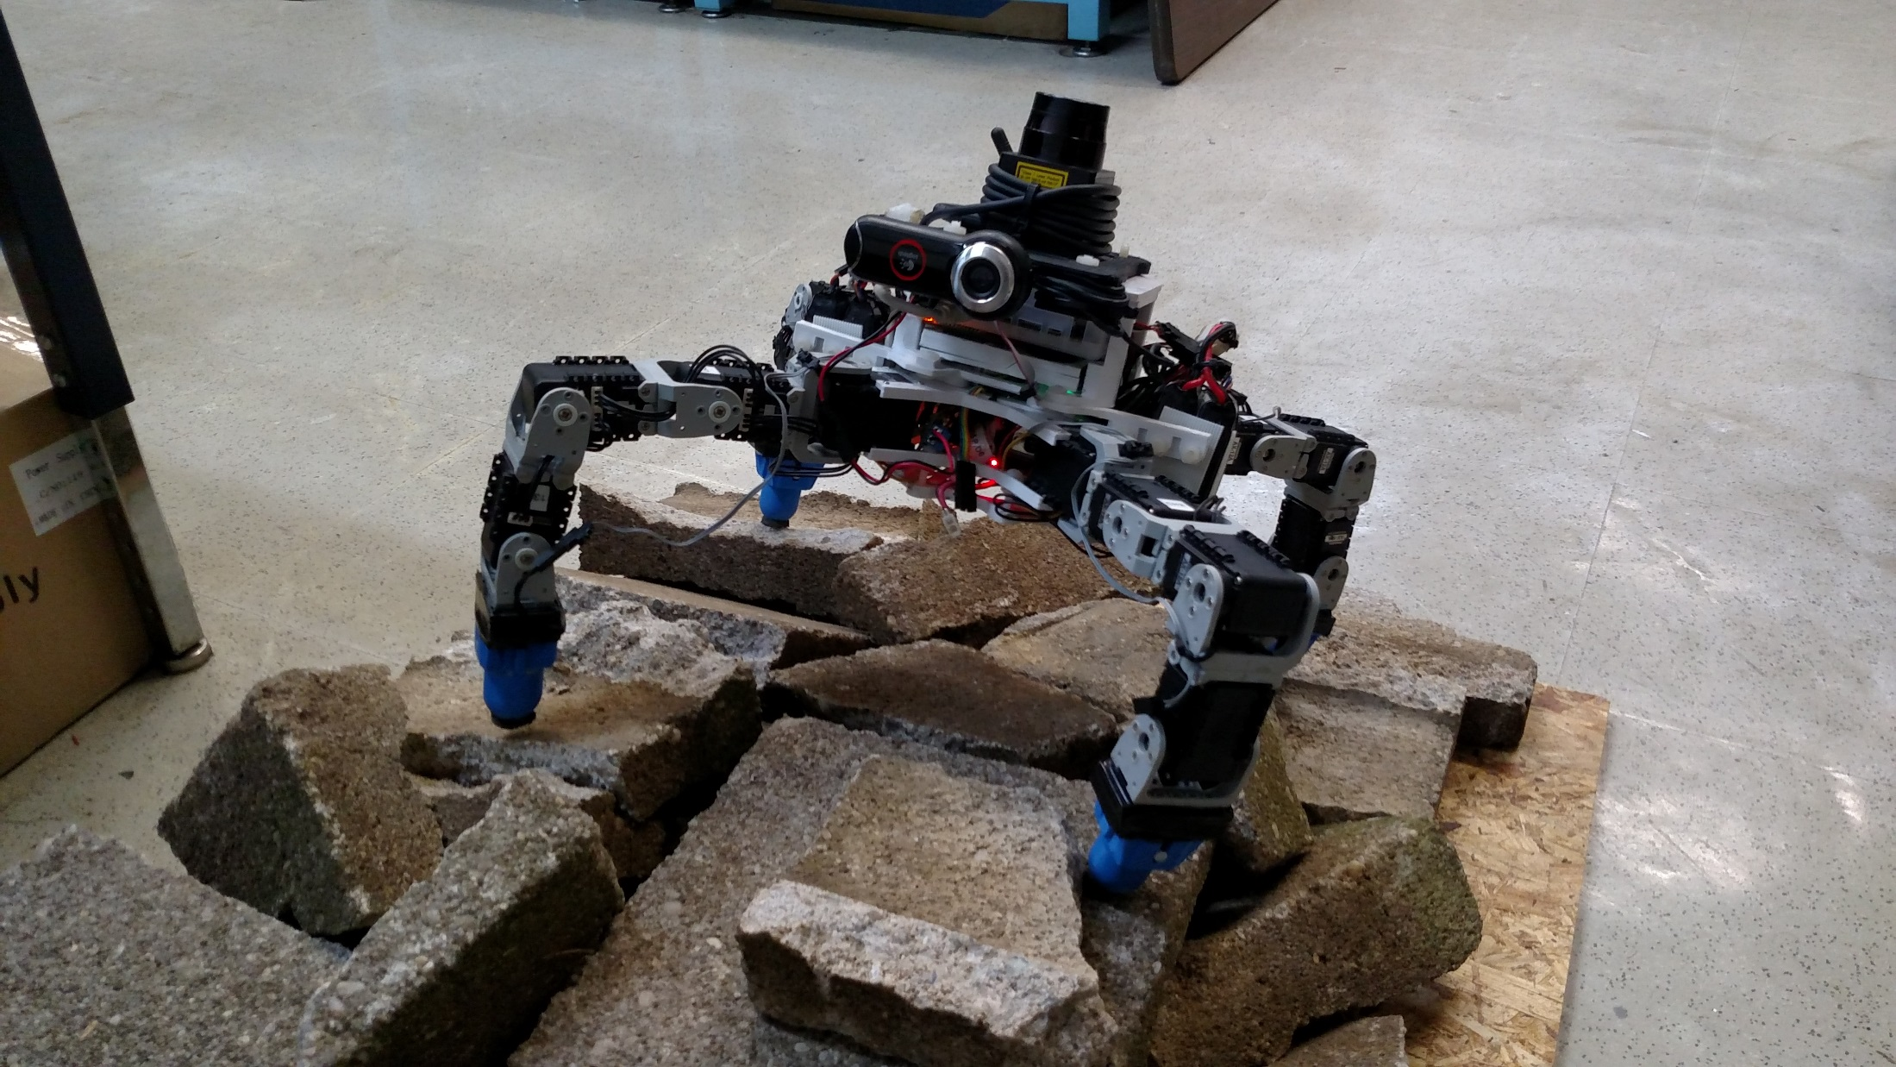
Introduction: The BlueFoot Platform

Slide 8
Introduction: The BlueFoot Platform
Small-scale quadruped robot
16 actuated degrees of freedom
High Dexterity:
Stabilize and reposition on rough terrain
Trunk articulation
Overcome raised/uneven terrain

Slide 9
Introduction: Control Overview
Central Pattern Generator (CPG)-based gait control
Zero-Moment Point (ZMP) body posture control
Virtual-Force foothold controller
NARX-Neural Network based trunk-leveling controller

Slide 10
Introduction: Navigation/Control Overview
Potential-Fields/Visual-Servoing control
Surface Reconstruction for rough terrain navigation
3D Point clouds from 2D LIDAR scans
Height-map Generation
Surface Estimation
Rough terrain planning using Height-maps

Slide 11
Design: Overview
Modularity between body segments
Robot consists of 3 main sections
3D Printed structures
Lightweight
Rapid design iterations
Facilitates modular design

Slide 12
Design: Core Devices
AutoPilot (TM4C, RM48 microprocessors)
IMU
Magnetometer
Pressure/Humidity Sensor
GPS
Dynamixel Serial Servos
Foot Contact Sensors
ODROID-XU Computer
Camera
LIDAR

Slide 13
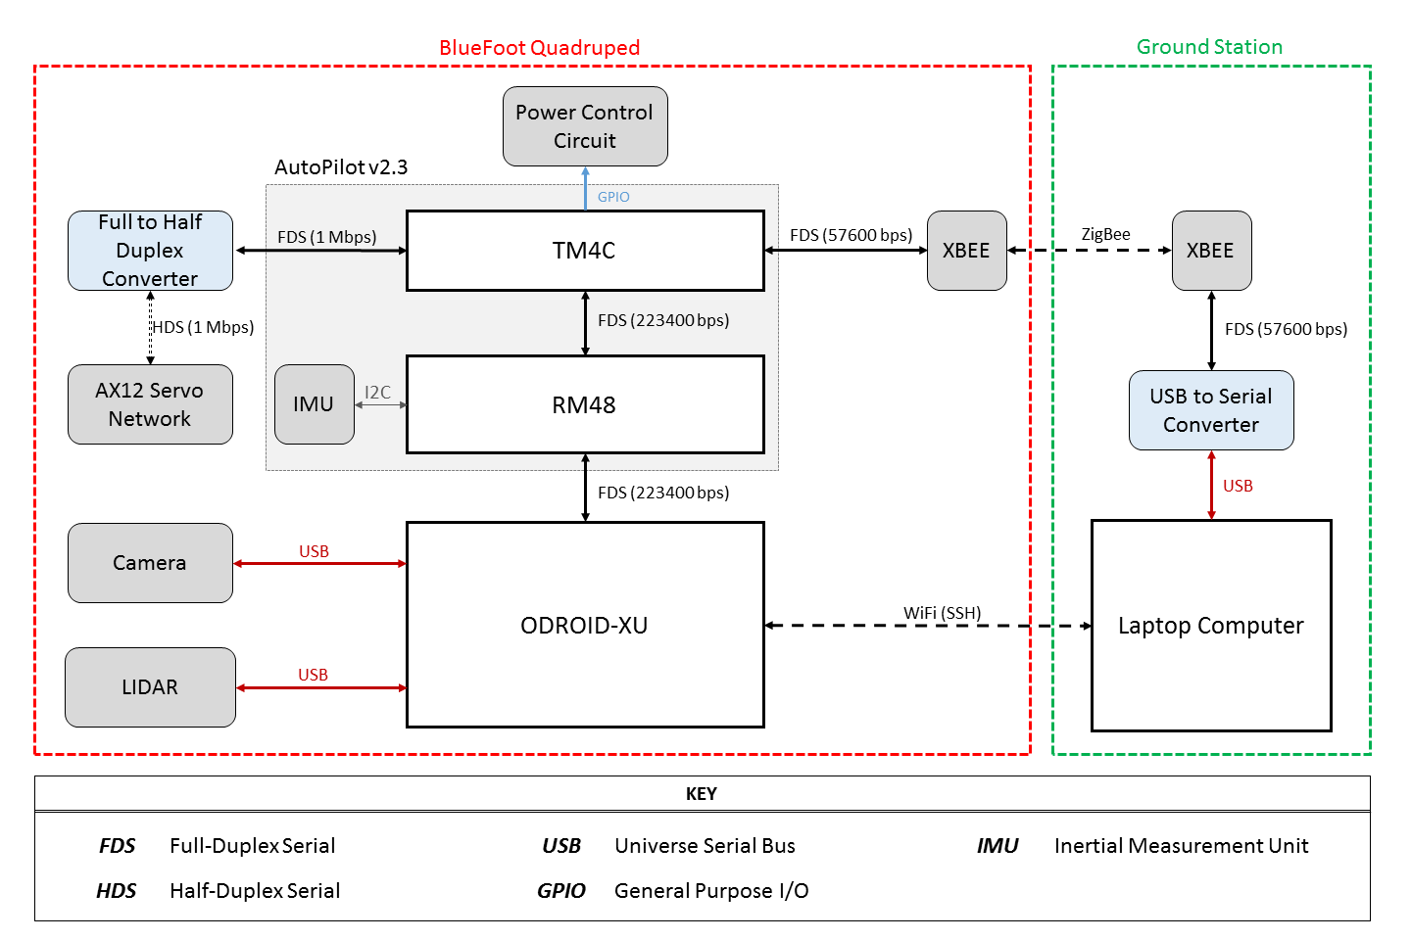
Design: Device Association

Slide 14
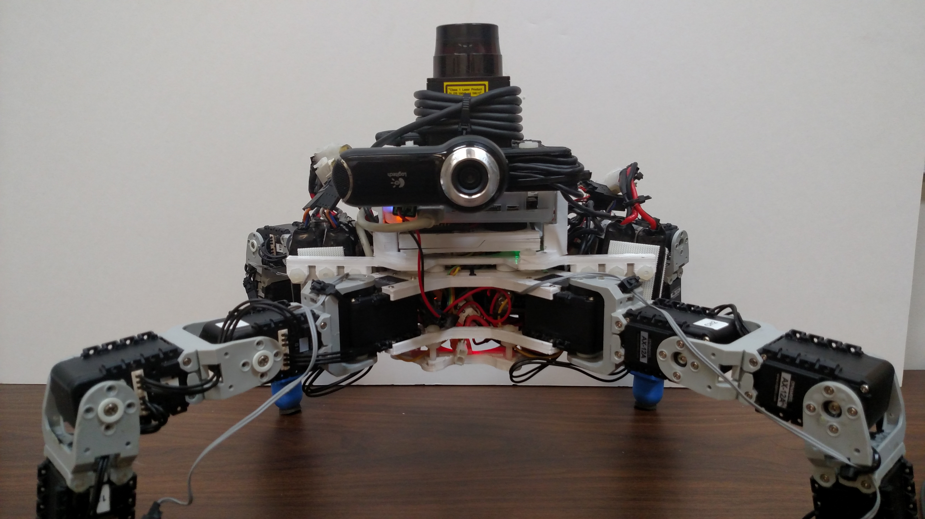
Design: Layout

Slide 15
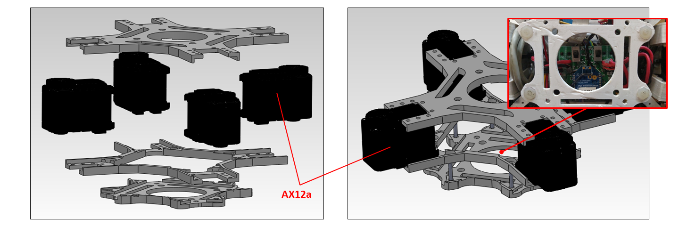
Design: Lower Body (Root Module)

Slide 16
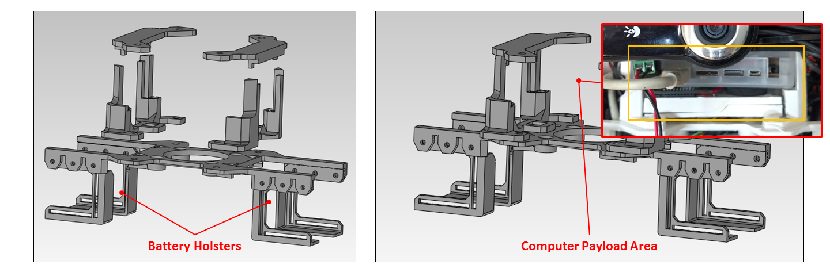
Design: Mid Body (Main Module)

Slide 17
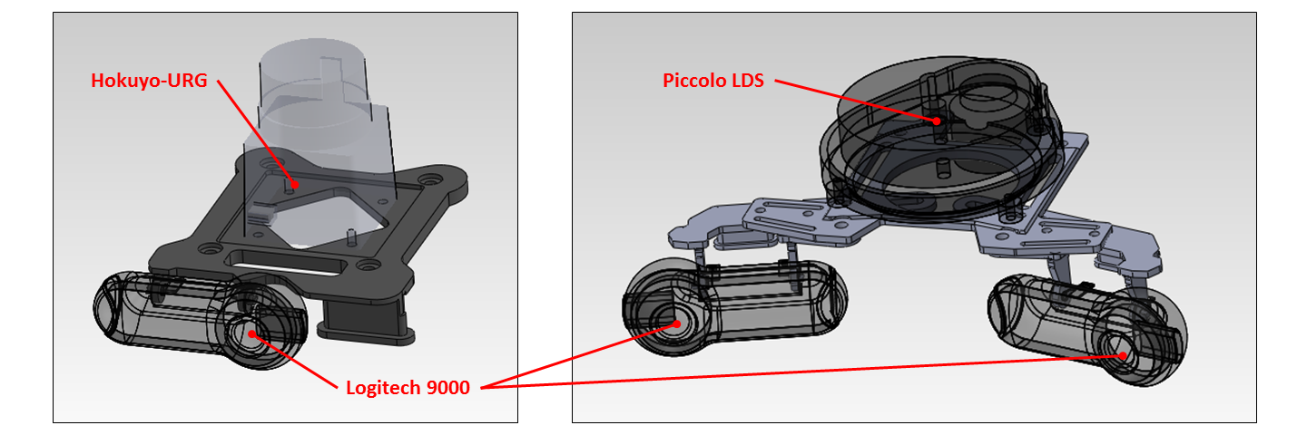
Design: Upper Body (Head Module)

Slide 18
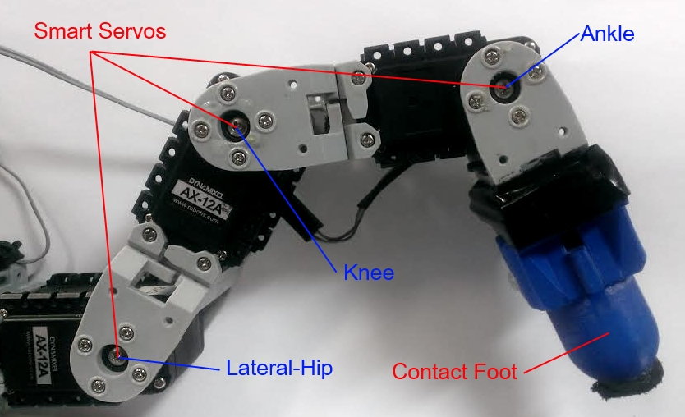
Design: Legs

Slide 19
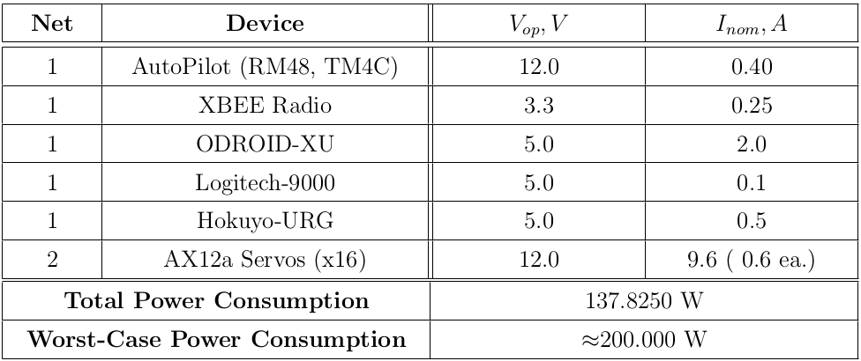
Design: Power Requirements

Slide 20
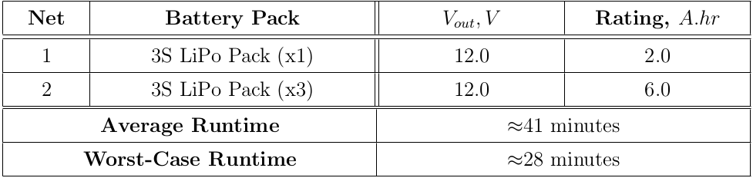
Design: Power Capacity and Run-time

Slide 21
Software: Overview

Slide 22
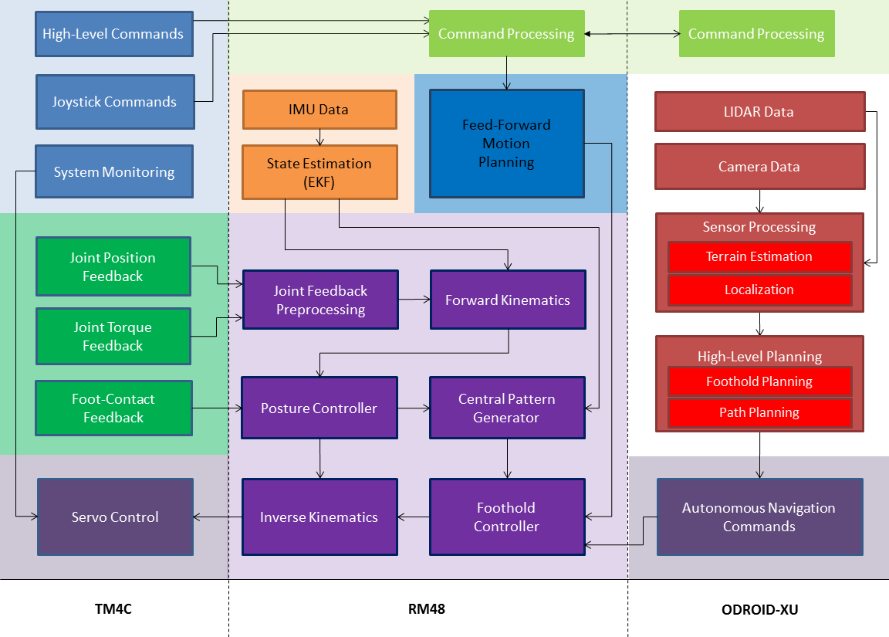

Slide 23
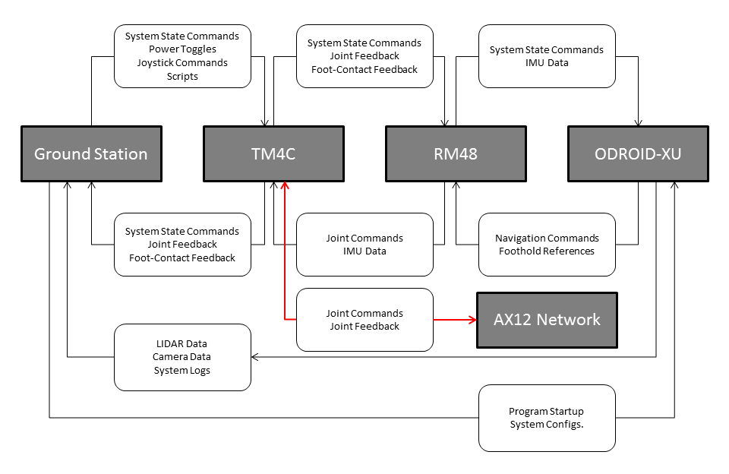

Slide 24
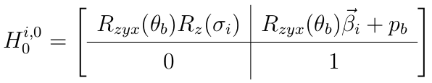
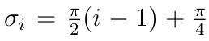
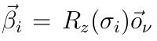
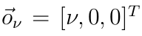
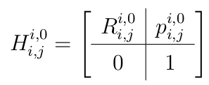
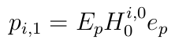
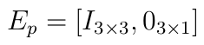
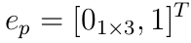
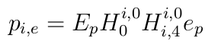
Position Kinematics

Slide 25
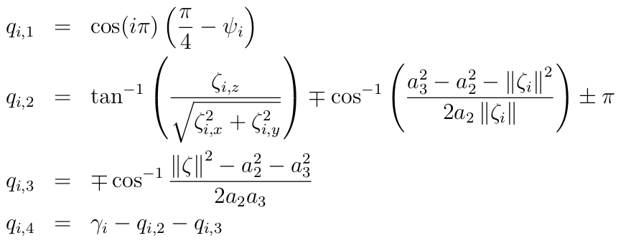
Inverse Position Kinematics

Slide 26
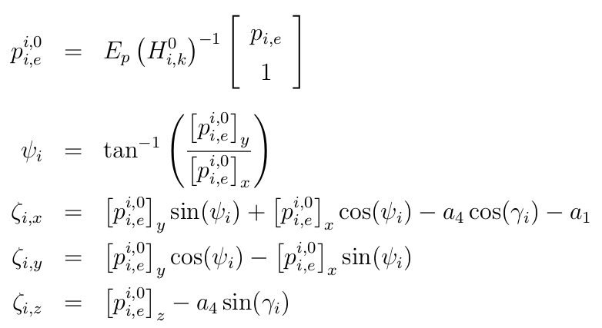
Inverse Position Kinematics, cont.

Slide 27
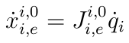
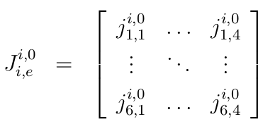
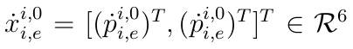
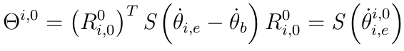
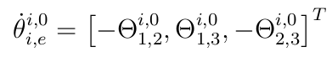
Velocity Kinematics

Slide 28
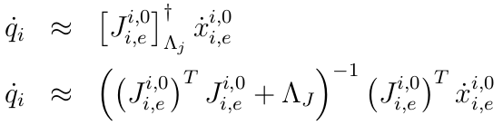
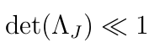
Inverse Velocity Kinematics

Slide 29
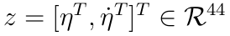
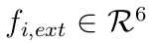
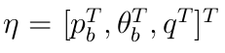
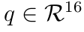
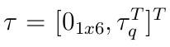
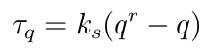
Dynamical Model

Slide 30
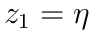
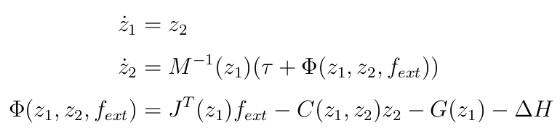
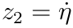
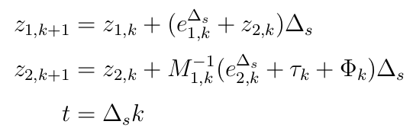
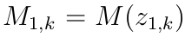
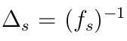
Dynamical Model, cont.

Slide 31
BlueFoot Simulator

Slide 32
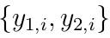
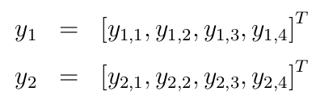
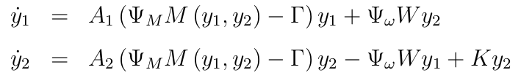
CPG with Hopf Unit Oscillators

Slide 33
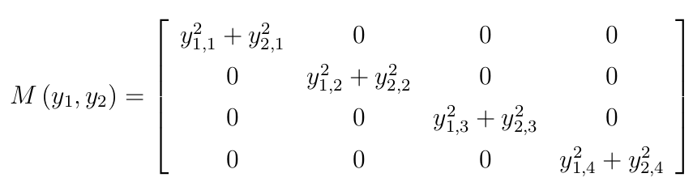
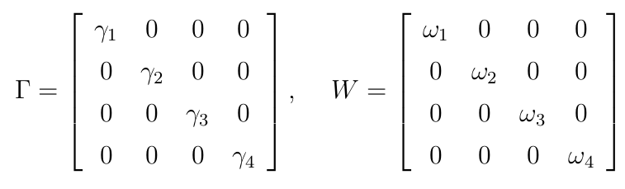
CPG with Hopf Unit Oscillators, cont.

Slide 34
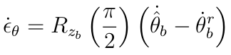
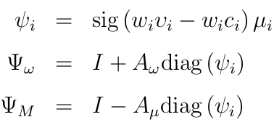
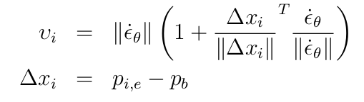
Reflexive CPG Design

Slide 35
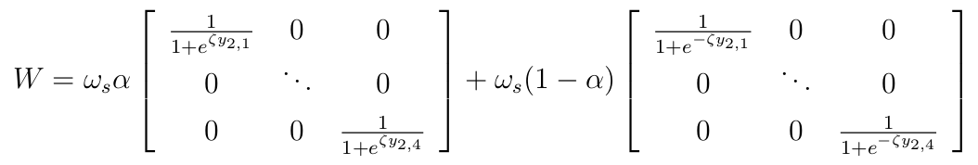

Reflexive CPG Design, cont.

Slide 36


CPG Gait/Coupling Design

Slide 37





Foothold Controller

Slide 38


ZMP Body-Placement Controller

Slide 39


ZMP Body-Placement Controller, cont.

Slide 40



ZMP Body-Placement Controller, cont.

Slide 41


NARX-NN Trunk Leveling Controller

Slide 42




NARX-NN Training Regimen

Slide 43


NARX-NN Training Regimen, cont.

Slide 44

NARX-NN Control Law

Slide 45

Source Point Cloud (1)

Slide 46

Surface Normal Estimation (2)

Slide 47

Source Point Cloud (2)

Slide 48

Surface Normal Estimation (2)

Slide 49


